Slide 1
Consuming Web Services
420-C50 S18
Notes:
Reference: http://www.codeproject.com/Articles/21045/Different-methods-to-call-Web-Services-from-AJAX

Slide 2
Web Services – Server Side
Recap:
SOAP
Service defined by WSDL
SOAP formatted message to access service
.NET has a nice way of building Service Reference (proxies) to access remote services

Slide 3
Method 1: Server-side proxy
//WebService
[WebService(Namespace = "http://tempuri.org/")]
[WebServiceBinding(ConformsTo = WsiProfiles.BasicProfile1_1)]
public class MyService : System.Web.Services.WebService
{
[WebMethod]
public string HelloWorld()
{
return "Hello World " + DateTime.Now.ToString();
//Or call the method on the real webservice traditional way
}
}

Slide 4
Method 1: Server-side proxy
// Client ASPX
<body>
<form id="form1" runat="server">
<asp:ScriptManager ID="ScriptManager1" runat="server" />
<asp:Label ID="Label1" runat="server"></asp:Label>
<asp:Button ID="Button1" runat="server"
OnClick="Button1_Click" Text="Button" />
</form>
</body>
// Client code-behind
public partial class _Default : System.Web.UI.Page
{
protected void Button1_Click(object sender, EventArgs e)
{
MyService myService = new MyService();
Label1.Text = myService.HelloWorld();
}
}
Notes:
Code behind is running on the server side.
The Web Forms is just posting back to the server, but the server is invoking the service (be it local or remote).

Slide 5
Web Services – Client Side JS proxy
.NET framework
Method 2: Javascript/AJAX
.NET will dynamically generate a javascript proxy for you to call it’s service!
Append ‘/js’ to any service.asmx to get a copy of the javascript proxy
Notes:
Somewhat adapted from : http://www.codeproject.com/Articles/627082/How-to-Consume-WCF-Service-using-JavaScript-Proxy#_comments

Slide 6
Method 2: Client Side JS proxy
.NET framework
Method 2: Javascript/AJAX
.NET will dynamically generate a javascript proxy for you to call it’s service!
Append ‘/js’ to any service.asmx to get a copy of the javascript proxy
Notes:
Somewhat adapted from : http://www.codeproject.com/Articles/627082/How-to-Consume-WCF-Service-using-JavaScript-Proxy#_comments

Slide 7
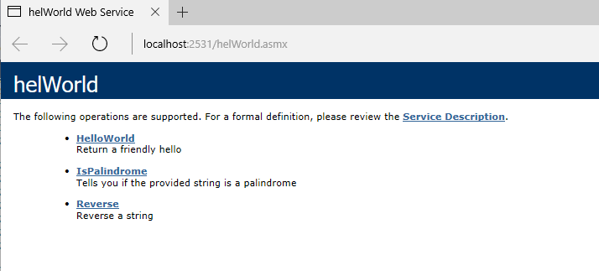
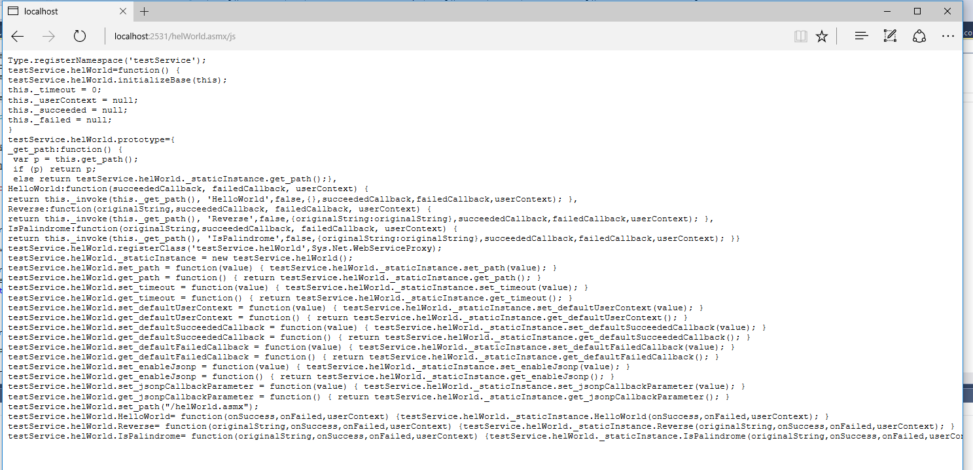
Method 2: Client Side JS proxy
Notes:
Somewhat adapted from : http://www.codeproject.com/Articles/627082/How-to-Consume-WCF-Service-using-JavaScript-Proxy#_comments
Look! It automatically creates a JavaScript Proxy

Slide 8
Method 2: Client Side JS proxy
<head runat="server">
<title>Call WCF from JS</title>
<script src="Scripts/jquery-1.10.2.js"></script>
<script src="Scripts/WebForms/MSAjax/MicrosoftAjax.js"></script>
<script src="Service/DemoWCFService.svc/js"></script>
<script type="text/javascript">
$(function () {
$("#btnCallService").click(
function () {
CallWCF();
})
});
function CallWCF() {
var service = new tempuri.org.IDemoWCFService();
service.SayHello($("#txtName").val(),
function (result) {
$("#dvMessage").html(result);
});
}
</script>
</head>
Pull in JavaScript Proxy code for service
Using the generated proxy to call a Web service (“Say Hello”);
Notes:
From a different service, but you get the idea:
The service generates a JS proxy dynamically that can be used for JavaScript.
This is completely run from the client side in JavaScript using an automatically generated javascript proxy.

Slide 9
Method 3: JavaScript/AJAX (raw, build your own)
Method 3: Javascript/AJAX POST
SOAP
Build up your own SOAP requests
ReST
Build your own HTTP requests
Study carefully the code samples the .NET provides for WSDLs
Note: does not have to be JavaScript/AJAX, any language that gets you to build and send SOAP or ReST message.
Notes:
Method 3: because it’s not always about .NET

Slide 10
Method 3: BYO SOAP
function buildSoapMessage( total_in, percentage_in)
{
var SoapMessage = '<soap:Envelope xmlns:xsi="http://www.w3.org/2001/XMLSchema-instance" xmlns:xsd="http://www.w3.org/2001/XMLSchema" xmlns:soap="http://schemas.xmlsoap.org/soap/envelope/"> \
<soap:Body> \
<TipCalculator xmlns="http://cegep-heritage.qc.ca/"> \
<total>' + total_in +'</total> \
<percentage>' + percentage_in + '</percentage> \
</TipCalculator> \
</soap:Body> \
</soap:Envelope>';
return SoapMessage;
}
function sendSoapMessage(url_in, soapRequest_in)
{
$.ajax({
type: "POST",
url: url_in,
dataType: "xml",
data: soapRequest_in,
contentType: "text/xml; charset=\"utf-8\"",
headers: {
SOAPAction: "http://cegep-heritage.qc.ca/TipCalculator"
},
success: handleResponse,
error: handleError
})
}
Notes:
Code behind is running on the server side.
The Web Forms is just posting back to the server, but the server is invoking the service (be it local or remote).

Slide 11
Method 3: BYO ReST
function sendHTTPMessage(url_in, message_in)
{
$.ajax({
type: "POST",
url: url_in, // URL to post to
data: message_in, // message content i.e. parm1=val1&parm2=val2
contentType: "application/x-www-form-urlencoded; charset=UTF-8",
dataType: "text", // the data type we want back, so text. The data will come wrapped in xml
success: handleData,
error: handleError
});
}
Notes:
Code behind is running on the server side.
The Web Forms is just posting back to the server, but the server is invoking the service (be it local or remote).

